Slide 1
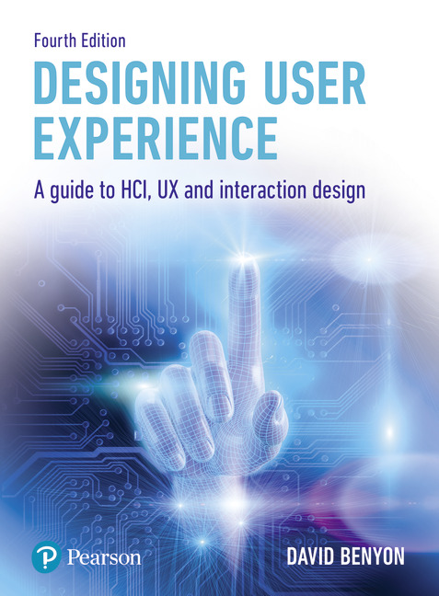
Designing User Experience
A guide to HCI, UX and Interaction Design
Fourth Edition
Chapter 8
Envisionment

Slide 2
Contents
8.1 Finding suitable representations
8.2 Sketching for ideation
8.3 Visualizing look and feel
8.4 Mapping the interaction
8.5 Wireframes
8.6 Prototypes
8.7 Envisionment in practice

Slide 3
Overview
Envisionment is concerned with making ideas visible, with externalizing thoughts.
Externalization can take all manner of forms: stories and scenarios, presentations, sketches, formal models, software prototypes, cardboard models and so on.
Different forms of representation will be more or less useful at different stages in the design process and more or less effective for doing different things.
A formal presentation of a design concept for a potential client will look quite different from a sketch of a screen layout intended to explore what something will look like.
Envisionment is needed to represent design work to ourselves and to others.
It occurs throughout development as the designer generates multiple design solutions and whittles them down to a final product or service.

Slide 4
Aims
In this chapter, we consider the principal envisionment techniques, various forms of prototyping used to explore and evaluate ideas and the presentation of ideas to clients.
But first of all, we review ways of thinking about the ideas to be externalized.
After studying this chapter you should be able to:
Use a variety of techniques for envisioning design problems and possible solutions.
Understand the role of concrete scenarios in envisioning design.
Select and use appropriate prototyping techniques.
Understand the main factors in communicating designs effectively.

Slide 5
Finding suitable representations
Envisionment is fundamental to effective human-centred design, to enable designers to see things from other people’s perspectives and to explore design concepts and ideas with others.
Different representations of design ideas are useful at different stages for different people.
They help with generation, communication and evaluation of ideas.
A sketch ‘on the back of an envelope’ might be useful for generating an idea and expressing it to a colleague – but it is not so good for giving to a client.

Slide 6
Design space
Design can be seen as the exploration and definition of a design space where both the problem and the solution evolve through the iterative process of envisionment and evaluation (Beaudouin-Lafon and Mackay, 2012).
The space is constrained by what is technologically possible and what is feasible within those constraints (such as time and money).
But the space is also open to the opportunities for new human experiences.
Different forms of envisionment enable designers to explore different perspectives on the space of alternatives.
As design ideas firm up, so the space of the interaction can be more closely defined with defined paths through the space describing user journeys of interaction.

Slide 7
Different techniques
There are many techniques that can be used to help develop an understanding of the design problem and to envision possible solutions.
None of these techniques in themselves will lead to the perfect design but they will all generate some kind of document or representation that can be used in the process of communicating with clients, customers and colleagues.
It is through communication that design solutions will arise, be evaluated and (eventually) be transformed into a final service or product.
Which techniques are used on a particular project will depend on a number of factors: the working style of the development team, the type of project, the resources available and so on.
Choosing suitable representations for the task at hand is one of the skills of a designer, another is making good use of that representation.

Slide 8
Representations
Representations work by suppressing unnecessary detail, thus ensuring that the significant features of some artefact or activity stand out.
A good representation is accurate enough to reflect the features of the system being modelled but simple enough to avoid confusion.
It adopts a style of presentation that is suitable for its purpose.
Consider the following example:
A car designer has been commissioned to produce a new luxury sports car. He or she doodles a few designs on paper and shows them to other designers on the team. They make some comments and criticisms and as a result changes are made. Finally, the designer is satisfied with one of the designs and draws up detailed blueprints that are given to the firm’s model maker. Scale models are produced and sent to Marketing and Sales for customer reaction. The scale models are also subjected to wind tunnel experiments to investigate the aerodynamics of the design and the results are used in a computer program that will calculate the car’s speed and fuel efficiency.

Slide 9
Car design example
The designer is using four different representations in at least four different ways:
The original representations focus on clearing the mind. In this case, they are doodles and sketches that are used to generate new ideas – ideation – , examine possibilities and prompt for questions.
The blueprints given to the model maker and the scale model given to the Marketing and Sales departments are suitable for accurately expressing ideas to others.
The wind tunnel experiments show representations being used to test ideas.
The computer model is used to make predictions.

Slide 10
Challenge 8.1
Which representations in the example above are being used to explore the problem? Which are being used to communicate ideas?

Slide 11
An outline envisionment process
Review the design brief, any constraints and requirements and conceptual scenarios.
Develop representations of your design ideas. This is the process of ideation. Sketching is central to the process. The aim is to generate many ideas to explore the spaces of possible experiences (this chapter).
If your service or product is a new one, experiment with different metaphors and design concepts through your representations (see Chapter 9).
Develop the ‘look and feel’ of the service or product, sketch out the touchpoints, channels of interaction and navigational structure of the whole UX (this chapter).
Explore design ideas with the people who will be using the system wherever possible (using techniques described in Chapter 7).
Develop wireframes to provide more detail on the proposed structure and navigation (this chapter).
Iterate and gradually formalize the design (making it more concrete) through prototypes and further evaluations (Chapter 10).

Slide 12
Sketching for ideation
Envisionment is about bringing abstract ideas to life.
It is easy to have great ideas in your head but it is only by envisioning them that the flaws and difficulties will be exposed.
Sketching will also help generate ideas.
There are a number of basic techniques that can help.

Slide 13
The art of sketching
The art of sketching is something that all designers should practice.
Ideas and thoughts can be quickly visualized – either to yourself, or to others – and explored.
The Millennium Bridge across the River Thames in London was reputedly designed on a paper napkin in a restaurant.
Designers do well to carry a sketchbook with them so that inspiration can be quickly captured and preserved.

Slide 14
Sketching user experiences (1 of 2)
Bill Buxton, a UX designer at Microsoft, has promoted the importance of sketching in his book Sketching User Experiences, and Greenberg, et al. (2012) provide an excellent workbook providing practical advice on sketching for UX.
They also provide a rich on-line resource.
Buxton argues that sketches are quick, timely, inexpensive, disposable and plentiful.
The UX designer should be happy to throw away sketches and so not get too committed to particular design features.
Buxton continues by identifying that sketches need a clear vocabulary, have ‘distinct gesture’ (fluidity), minimal detail and an appropriate degree of refinement.

Slide 15
Sketching user experiences (2 of 2)
Buxton’s final considerations for sketches are that they should suggest and explore, rather than confirm and provide some ambiguity.
Sketches are there to encourage people to question and to fill in the gaps.
Figure 8.1 shows an example of a sketch for the interface to an interactive shopping service.
Greenberg et al. (2012) emphasize that in addition to the elements shown in Figure 8.2, sketches can include annotations, arrows (to show movement or to highlight particular areas of the sketch) and notes about issues that the designer has yet to resolve.
Individual snapshots of a design can be provided to show key moments in an interaction (e.g. Figure 8.2) and are particularly useful for exploring the impact of a certain style or design idea.
Snapshots can be single sketches or frames from a storyboard (see below).

Slide 16
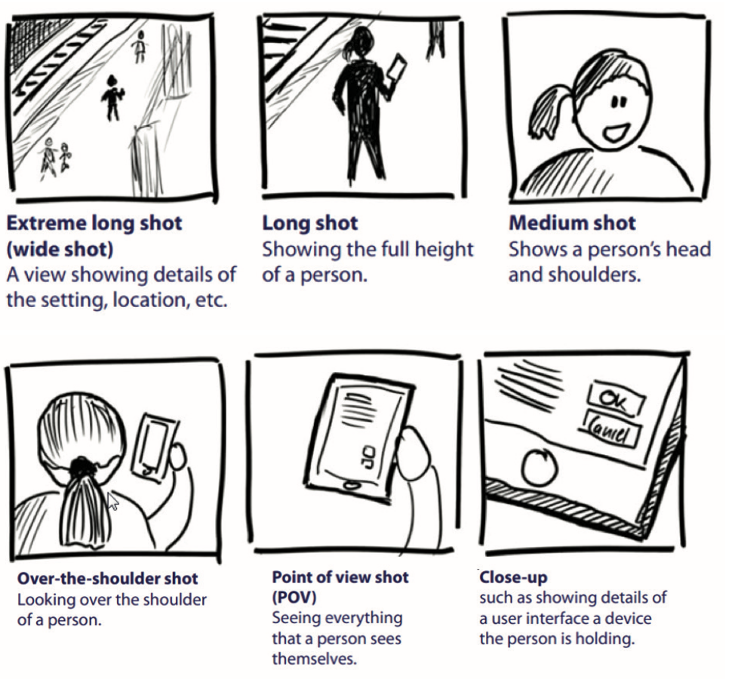
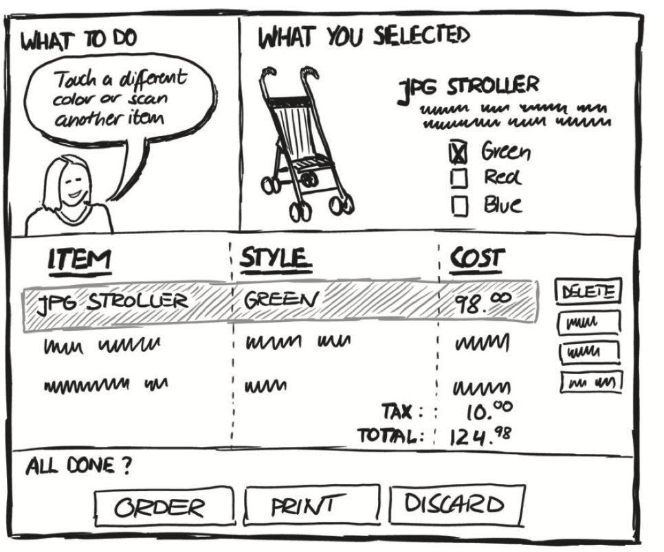
Sketching
Notes:
Figure 8.1 A sketch for the interface to an interactive shopping service
Figure 8.2 Snapshot of a key moment in an interaction

Slide 17
Storyboarding
Three main types of storyboarding are commonly found in interactive media design:
Traditional storyboarding. A storyboard for a film would usually have some notes attached to each scene expanding on what will happen – this helps overcome the limitations of representing a dynamic experience in a static medium. In UX design, notes below each sketch usually contain the relevant steps from a scenario and the sketches themselves.
Scored storyboards. If the application has a lot of motion graphics, the storyboard can be annotated – a sketch is annotated with appropriate notation and notes about, for example, type, colours, images, sound and other issues attached underneath.
Text-only storyboards. These are useful if the application has a lot of very complex sequences. You can specify what images appear, what text accompanies them, any accompanying media, general notes about tone, flow, etc.

Slide 18
Narrative storyboards (1 of 2)
Greenberg et al. (2012) recommend developing narrative storyboards for key moments of a proposed user experience.
They use five scenes to describe a typical UX.
The structure has a beginning scene, two scenes showing the story developing, the climax of the story and the ending scene.
A key difference between sketching snapshots and sketching narratives is to capture some more of the context of the UX.
With narrative storyboarding, the designer can show more of the whole UX that is being designed.

Slide 19
Narrative storyboards (2 of 2)
Greenberg et al. (2012) provide examples in their book on how to sketch and how to get the idea of flow and movement into sketches.
They identify the different types of ‘shot’ that sketches can use to show the whole user journey through an experience from an opening long shot to a close up (see Figure 8.2), creating a representation like a film storyboard.
They also provide a vocabulary of familiar objects, people and activities that are frequently used in UX design.
In the example shown in Figure 8.3, they describe a user journey of someone being attracted by advertisement, scanning the advertisement with an app on their smartphone, getting some information and moving on.
The sketch uses different shots at different stages.
An extreme long shot to set the scene, an over the shoulder shot to illustrate what happens next and a close up to show what the user sees.
Adding arrows and annotation to the sketch results in the more fluid and expressive sketch of this particular UX as shown in Figure 8.4.

Slide 20
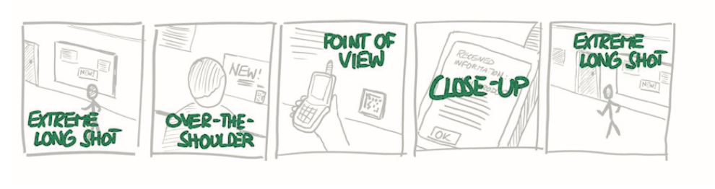
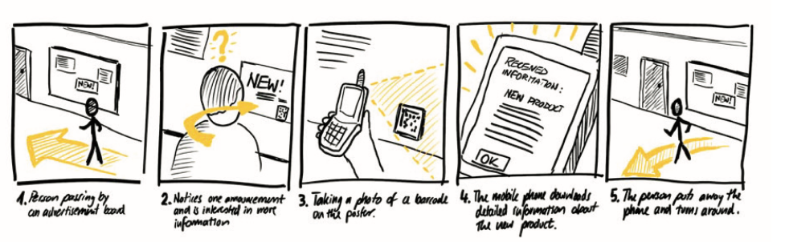
Storyboards
Notes:
Figure 8.3 A user journey of someone attracted by an advertisement
Figure 8.4 The addition of arrows and annotation

Slide 21
Hints and tips for sketching
Greenberg et al. (2012) provide a wealth of other hints and tips for sketching.
Sketching can be a collaborative experience where two or more designers work together to develop the ideas and of course sketches can be critiqued by a design team or focus group to explore design issues.
Designers can take photos of different scenes rather than draw them and put the photos together into a sketch.
Designers can annotate these photo-sketches with arrows and notes to add more detail and explanation.
Another alternative is to use sketching software. For example, Microsoft PowerPoint has a wide range of objects, arrows and other ways of helping designers to sketch out ideas and there are a number of specialist sketching apps.
However, designers should not lose sight of the power of sketching by hand.
The more fluid nature of the representation, the speed of production and the ability to throw away sketches that do not quite work help designers explore the problem domain in a way that software sketching does not encourage.

Slide 22
Visualizing look and feel
The interaction amongst people, services and products will often take place across different media channels and the UX will result from the complex interweaving of service moments.
Designers need ways to envision the various touchpoints, service moments and user journeys so that they can establish a common ‘look and feel’ for the whole UX.
The look (how things are represented) and feel (how things behave) should have some consistency across the different channels and should reflect the overall brand that the UX is aiming to establish.
In the case of a large organization, this branding will be very carefully controlled by the marketing department, but even for a smaller organization, there needs to be a recognizable style that crosses channels such as an app, a website, a promotional video and any paper-based media (such as business cards, fliers, posters and so on) contribute to the overall UX.

Slide 23
Emotion and feelings
As we discussed in Chapter 6, UX is inherently concerned with emotion and feelings of engagement.
Designers should aim to evoke particular meanings in their users.
They should aim to bring about those key aspects of experience design – identity, adaptivity, narrative, immersion and flow – along with the characteristics of evoking the different types of pleasure and characteristics of product attachment.
Designers need to establish the aesthetics of the product or service they are developing.
To do this, designers need to find some way to envision the feelings and sense of presence that users will have when they experience a service or product.
They must do this in a way that provides some consistency across channels and touchpoints.
The ultimate aim of this part of the envisionment process is to arrive at the design language that will characterize the service or product that is being designed.

Slide 24
Mood boards (1 of 2)
Mood boards are widely used in advertising and interior design.
Quite simply designers gather visual stimuli that capture something of the feeling about the design.
Photographs and other images, colours, textures, shapes, headlines from newspapers or magazines, quotations from people and pieces of fabric can all be used to contribute to this.
The stimuli can be attached to a physical pinboard or designers can make use of an online tool such as Pinterest.
Designers can put pages from websites they like on mood boards, video clips or snippets of animations that capture a certain aesthetic.
Andreas Lucero (2012) argues that mood boards are useful for ‘framing, aligning, paradoxing, abstracting and directing’ designers in their work on the look and feel of a product or service.

Slide 25
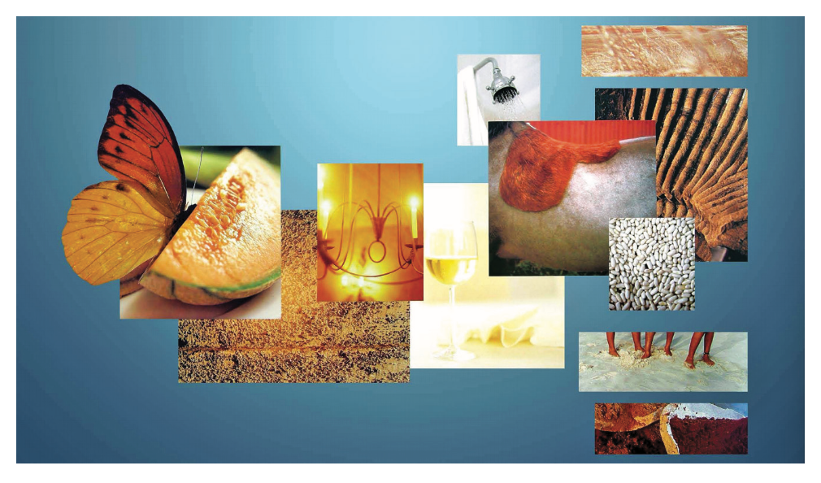
Example
He gives an example (Figure 8.5) on how a picture of a ripe melon was used to evoke a sense of smell that in turn suggests the experience of eating ripe fruit.
A picture of shower introduced the sense of fresh and clean experience of having a shower.
This produced a physical object that could be used in workshops with stakeholders to help them frame the design space, align it with other objectives of the product and raise paradoxes that lead to discussions and resolutions.
Ultimately, the process leads to a more abstract idea of the service that can direct the next stage of work.
Elsewhere, he discusses an interactive system that supports the presentation of mood boards, the ‘Funky Wall’ (Lucero, 2009).
Notes:
Figure 8.5 A mood board

Slide 26
Mood boards (2 of 2)
The rule with mood boards is that ‘anything goes’.
The point of the board is not to formally represent some aspect of the design, simply to act as inspiration – perhaps promoting a particular line of thought, or providing inspiration for a colour scheme.
One technique is to get the client to create a mood board. This can give you an insight into the kinds of aesthetics that are likely to appeal to them.

Slide 27
Descriptive adjectives
As a variation on the mood board concept, writing down adjectives that describe some aspect of the system can be useful.
You can envision the look of a service by writing down what emotions you want it to evoke in the users.
For example, you want to users to feel that this is a serious app, providing content that has been well researched and well-written but still retain some sense of adventure and intrigue.
Listing descriptive adjectives for a project will lead to a set of semantic scales that can subsequently be used for evaluation through semantic differentials.

Slide 28
Design workbooks
Bill Gaver uses a technique that he refers to as design workbooks (Gaver 2011).
These ‘are collections of design proposals and other materials drawn together during projects to investigate options for design’ (p. 1551).
The workbooks help designs that evolve slowly over time and capture lessons learnt from previous design activities.
One important aspect of Gaver’s approach is that he proposes methods for ambiguity in design (Gaver and Benford, 2003).
These envisionment methods (similar to technology probes described in Chapter 7) complement methods focused on requirements generation by raising issues, posing paradoxes and aiming to resolve them in a team.

Slide 29
Example: Explore Scot
We were working on an app for a competition run by TravoScotland to ‘provide a compelling interactive experience for visitors to Scotland’ in the year that they had designated the year of Innovation, Design and Architecture.
After several brainstorming sessions, we arrived at the concept of an interactive treasure hunt.
Tourists would be guided to particular location in Scotland and would then explore the area to find information about a famous person and what they had achieved.
When we looked at similar products and services, we found that the ‘treasure hunt’ look was generally aimed at children with pirate type characters, treasure chests and a cartoon like feel (go to Pinterest.com and see). This was not what we wanted.
We wanted to attract tourists as well as locals who were interested in discovering stories about the famous architects, designers and innovators of Scotland.
Creative architects and designers such as Charles Rennie Mackintosh and William Henry Playfair were to be celebrated along with examples of their work. The homes of innovators such as John Logie Baird (inventor of the television) and Alexander Graham Bell (inventor of the telephone) were to be highlighted along with details of their work.
With this general idea, we split into four groups of three people each to develop more of the look and feel that our service would have.

Slide 30
Great Scot workshops (1 of 2)
In the workshops, one group suggested that the overarching colour should be dark blue, with a white type face and yellow buttons.
The adjectives used were exciting, exhilarating, engaging, intriguing, vivid and modern.
One group suggested that the Forth Bridge would be a good logo, an iconic image that was itself a great example of innovation.
A polygon art interface brought these ideas of modernity.
Another group at the workshop focused on a previous app she had worked called ‘Go Scottie’ that used a small Scottie dog as its logo.
This led to the idea of calling the app Great Scott in order to capture the idea of great Scottish innovators but also as a reference to the Back to the Future films where ‘Great Scot’ was a phrase frequently used by Doc Brown to express amazement.
This group wanted a brighter palette for the design, with more colour. They wanted a feel more like the film Minority Report with its high-tech user interface.

Slide 31
Great Scot workshops (2 of 2)
Another group used the Holocaust Museum in New York as inspiration for a sensitive guide through history.
A fourth group drew inspiration from a Pokemon advert that was running at the time along with ideas from the Braveheart and Highlander films, historic battles and Scottish Kings and the Harry Potter films many of which were filmed in Scotland.
We put all these ideas together on flip charts and came together to discuss.
Finally, we arrived at the logo shown in Figure 8.6, using the purple colour (the same as the Scottish flag), and also quite a serious colour as used by The Guardian newspaper, the concept ‘Explore Scot’ because the content was to be about the innovation and architecture in Scotland with the ‘O’ looking like a pin on Apple or Google maps to illustrate the idea of finding interesting locations.
The logo and design would be central to a smartphone app that would guide people around areas of interest in Scotland.
The logo would also figure on the TravoScotland website where it would link to a video and on promotional material that would be available at the chosen sites.

Slide 32
Mapping the interaction
The techniques described in Sections 8.2 and 8.3 focus on exploration of the design space; ideation, look and feel.
As the process of design continues, designers will want to look at how the information space is structured and at the paths that users can take through the space.
Maps are forms of envisionment that focus on these aspects of interactive experiences.
As we discuss in Chapter 26, when we look at navigation and in Chapter 18 when we look at blended spaces, user experience in interactive and information spaces shares many characteristics with user experience in physical spaces.
Here the use of maps to help people find their way around towns and cities is well known.
So, for the interaction designer, there are methods for envisionment that focus on mapping different aspects of the overall UX.

Slide 33
Navigation maps
Navigation is a key feature for many systems.
Navigation maps focus on how people move through the site or application.
The aim is to focus on how people will experience the site.
Each page in the site, or location in an app, is represented with a box or heading and every page that can be accessed from that page should flow from it.
A useful tip is to put in all flows possible (i.e. back and forth from a page) as this will highlight sections where people might get stranded.
Navigation maps can usefully be redrawn many times through the project life cycle, as poor navigational structure is one of the main reasons people turn off a website, for example.
The maps can be used with scenarios to ‘walk through’ particular activities and are a very good way of spotting poor aspects of design such as ‘orphan pages’ (pages which are not accessible), dead ends or paths that are too long or too obscure.

Slide 34
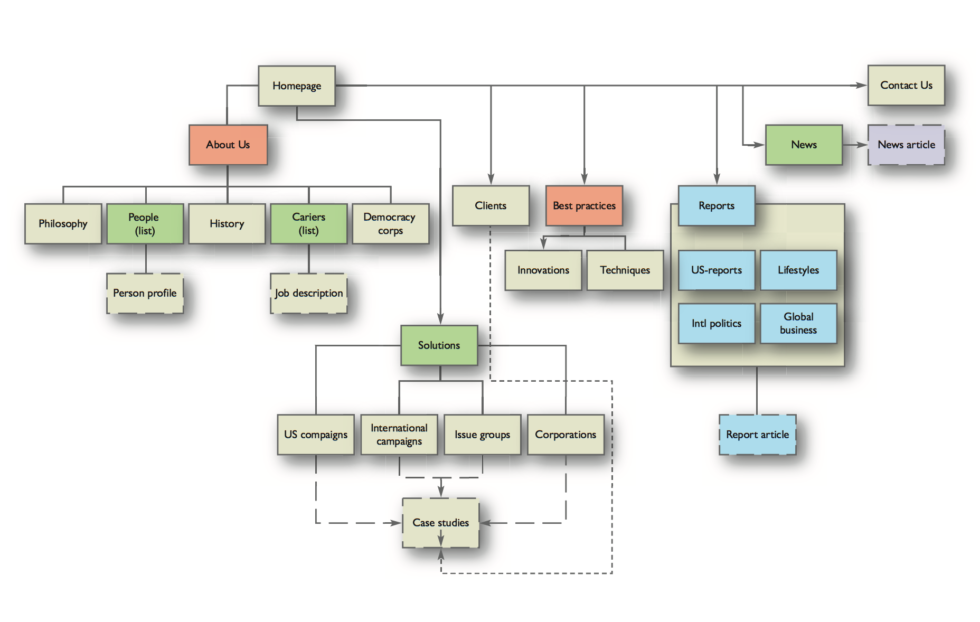
Figure 8.7
Navigation map for a website
Web site/app map

Slide 35
More maps (1 of 2)
Navigation is important in all manner of applications and products, not just websites.
Different notational conventions are used to show different types of content, perhaps distinguishing word documents (shown in dashed lines) from top level web pages from sub-pages.
Maps are useful for highlighting organizational structure, for example the organization of functions on a mobile phone.
An example of a user journey map is shown in Figure 8.9. We have already encountered user journey maps in Chapter 4.
This is a different version focusing on particular aspects of the interaction in this domain.

Slide 36
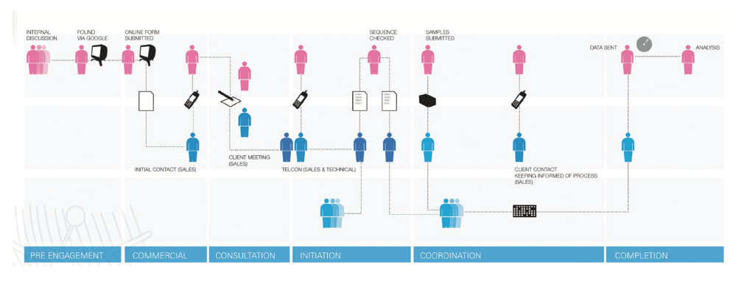
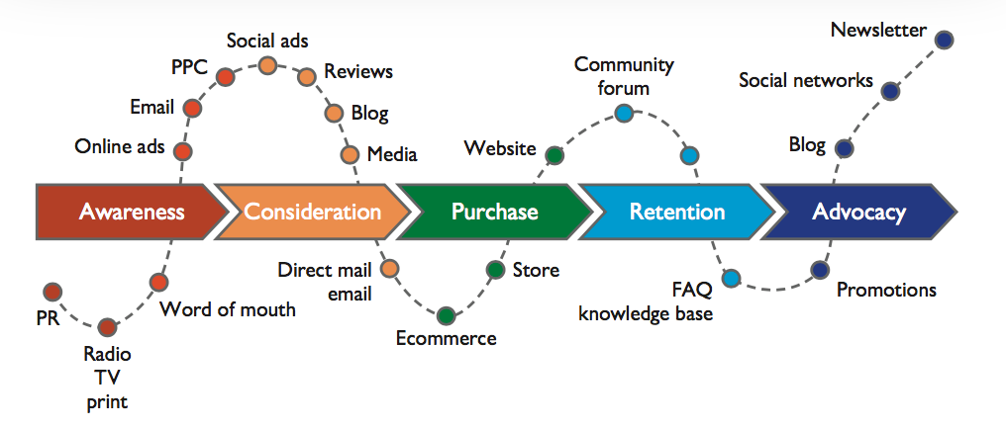
Journey maps
Notes:
Figure 8.9 A user journey map
Figure 8.10 A customer journey map

Slide 37
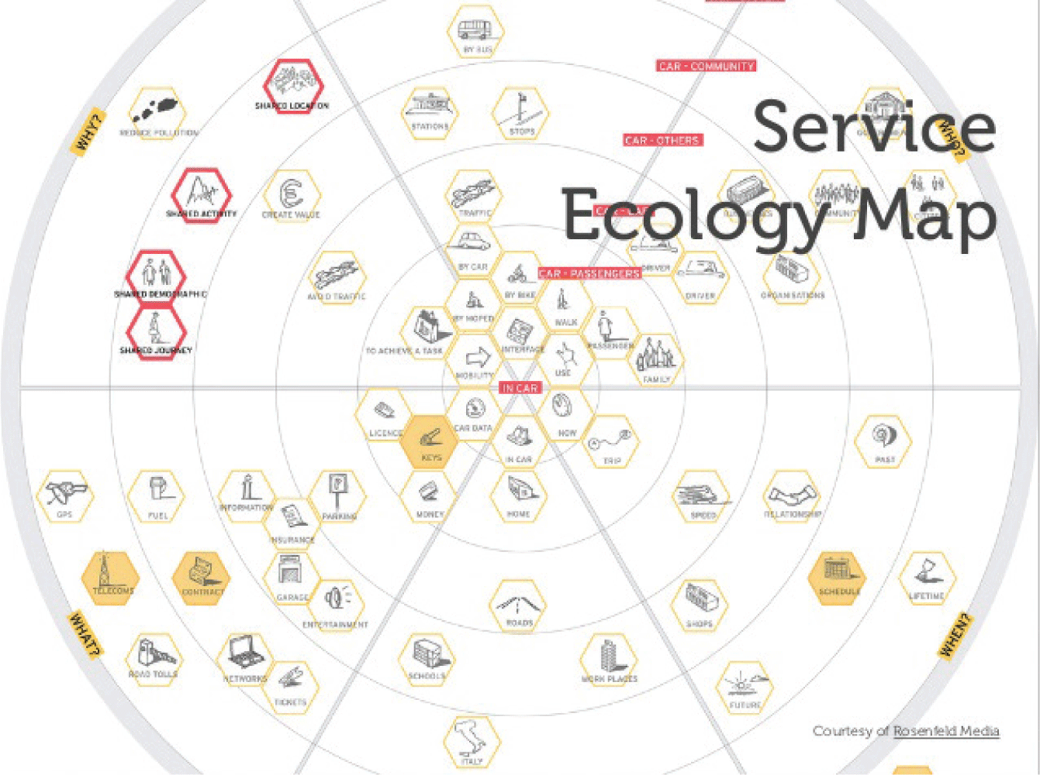
More maps (2 of 2)
Designers will often find themselves inventing new types of map to envision different aspects of the interaction. Figure 8.11 shows an actor map from the design company Live Work.
This illustrates another type of map that shows survey knowledge, rather than focusing on paths through the interaction.
Notes:
Figure 8.11 An actor/service ecology map

Slide 38
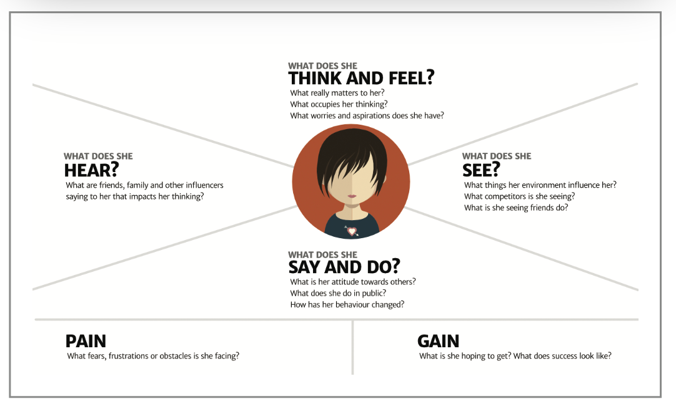
Persona/Empathy map
Of course personas, described in Chapter 3, are a form of visualization that focuses on mapping out the different users of the system or service under investigation.
An empathy map (Figure 8.12) can be a good way of mapping the key aspects of your personas.
Notes:
Figure 8.12 An empathy map

Slide 39
Wireframes (1 of 4)
Wireframes are outlines of the structure of a software system.
They focus on the interaction design and the information architecture of a product or service.
They used to be concerned principally with website design, but with the proliferation of small-scale apps for handheld and tablet devices, wireframing has become a mainstream technique.
With the developments of Cascading Style Sheets (CSS) and the specification language HTML5, the development of websites and the development of apps are becoming increasingly blurred and apps exist to easily animate pages of a design and turn them into a wireframe.
Just as navigation maps focus on how pages are structured and linked together, so wireframes focus on the structure of particular types of pages and on the navigation between pages.
Use the two together and you have the basics of an app or website design.

Slide 40
Wireframes (2 of 4)
Wireframes work because they focus on the general elements of a design without worrying about the final detail.
For example, in a mobile phone app, there are buttons, menu items and selections.
Wireframing makes use of these generic design features for both apps and websites to create quick designs often for quick evaluation.
Figure 8.14 shows a portion of the wireframe from the Great Scott app dealing with the function of users being able to create their own tours, deciding which attractions to see and getting information about possible destinations.
Software packages are available to help with developing wireframes.
The best known is Axure (www.axure.com) but there are a number of other alternatives.
These provide templates that constrain the design to the particular size and style of a particular delivery platform such as an iPhone.
Plenty of systems exist that will take mocked-up screenshots and add clickable links. This is how the wireframe in Figure 8.13 was achieved.

Slide 41
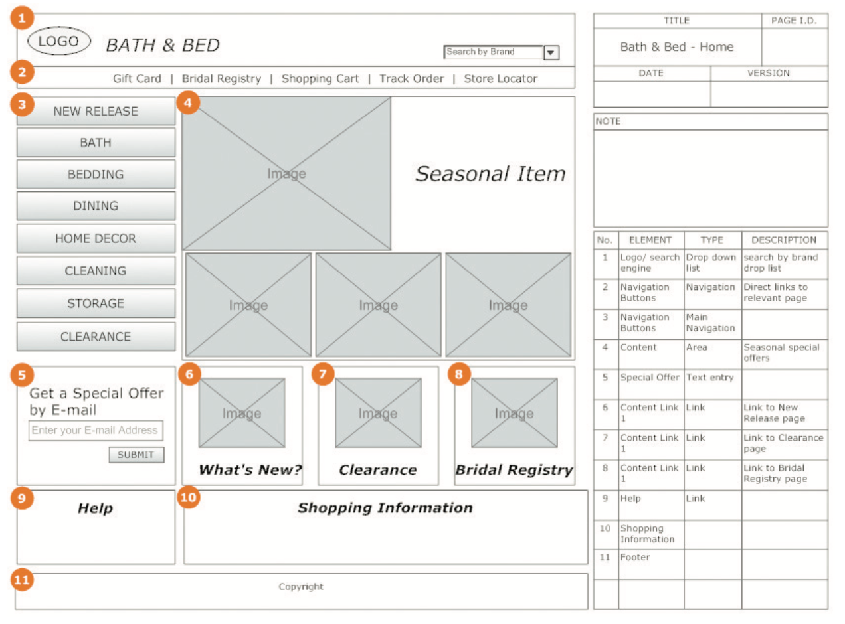
Wireframes (3 of 4)
Notes:
Figure 8.13 Examples of wireframes

Slide 42
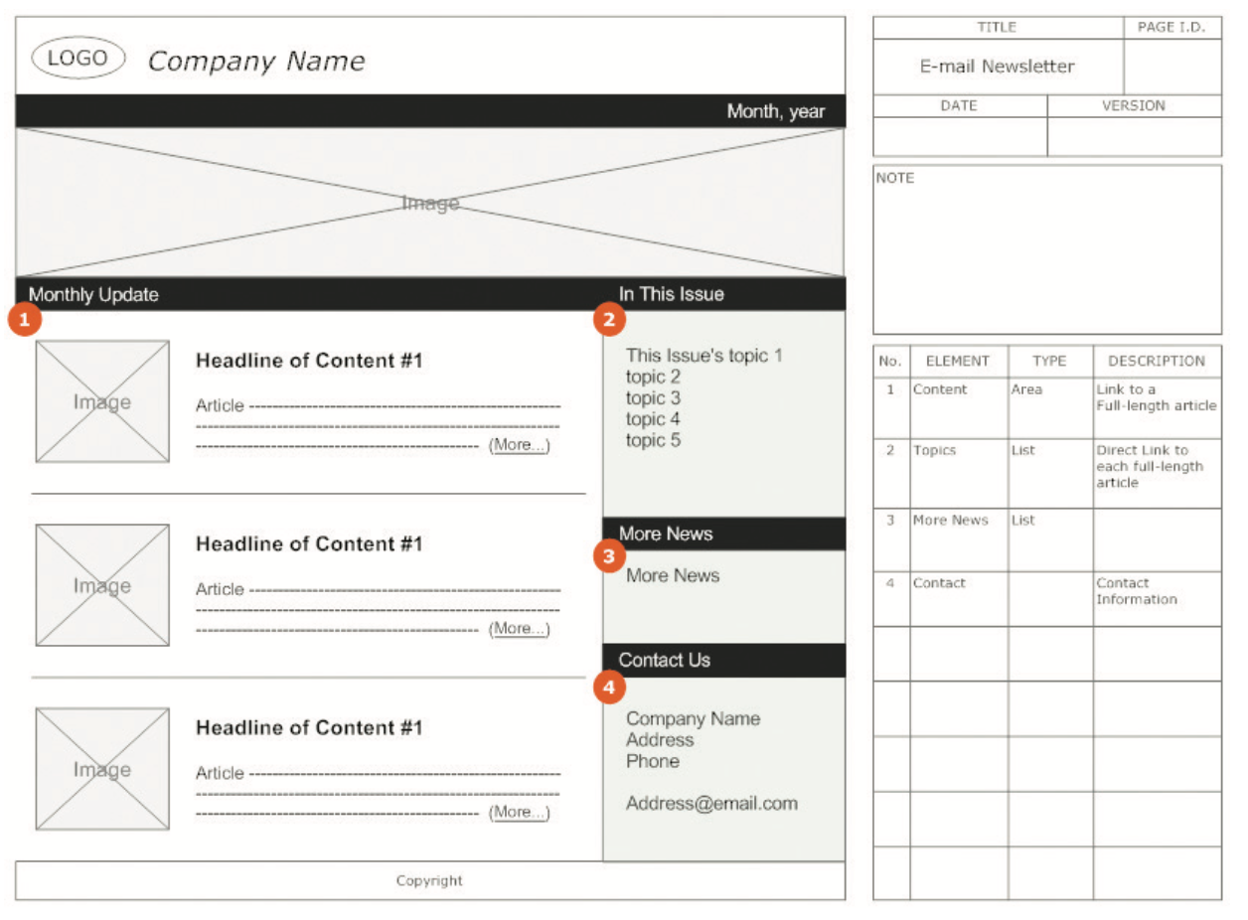
Wireframes (4 of 4)
Notes:
Figure 8.13 Examples of wireframes (Continued)

Slide 43
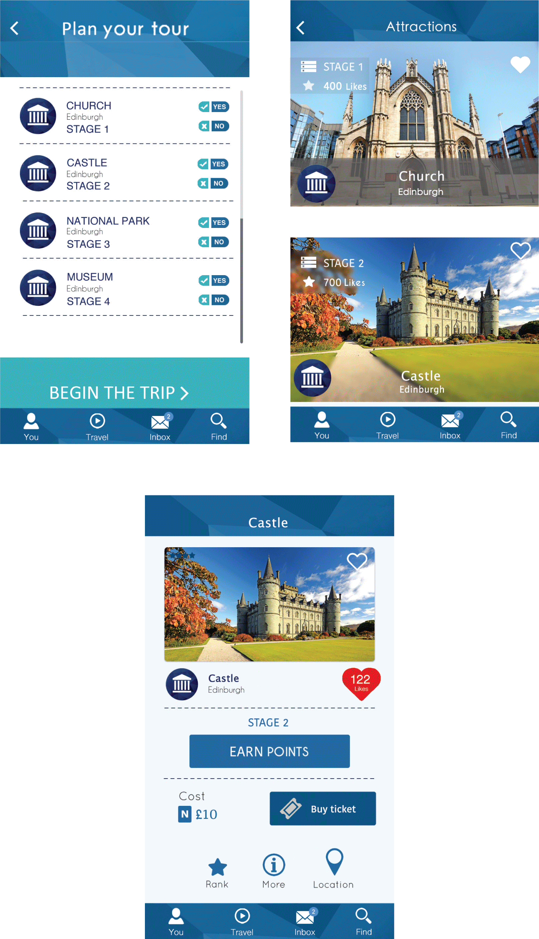
Notes:
Figure 8.14
A portion of the wireframe from the Explore Scot app

Slide 44
Prototypes
A prototype is a concrete but partial representation or implementation of a system design.
Prototypes are used extensively in most design and construction domains.
Lim et al. (2008) present a view of prototypes as
‘tools for traversing a design space where all possible design alternatives and their rationales can be explored … Designers communicate the rationales of their design decisions through prototypes. Prototypes stimulate reﬂections and designers use them to frame, reﬁne and discover possibilities in a design space’ (p. 72).
Prototypes may be used to demonstrate a concept (e.g. a prototype car) in early design, to test details of that concept at a later stage and sometimes as a specification for the final product.
A prototype may be made of something as simple as paper, cardboard or other suitable material or it may be developed using a sophisticated software package.

Slide 45
Prototyping (1 of 2)
The engineers in the Apollo space missions built a full-size cardboard prototype of the lunar landing module to test the position and size of the windows in relation to the field of view of the astronauts.
This experimentation led to the design decision that the astronauts would stand (not sit) inside the lander – thus allowing windows to be smaller and saving crucial weight.
In our domain of interactive systems design, representations such as screen sketches and simple early prototypes blend into each other.
But the main distinguishing characteristic of a prototype is that it is interactive.
Something happens when a person ‘presses’ a ‘button’ – even if the button is drawn on paper and the action consists of a menu on a Post-it Note being added by the designer.
The appropriateness of a prototype will depend on a number of factors such as whom the prototype is aimed at, the stage of the design process and what features the designer is looking to explore.

Slide 46
Prototyping (2 of 2)
For the design team, representations like navigation maps and flow charts might be meaningful, but for clients and ordinary people, some form of prototype is crucial for capturing the outcomes of the envisioning techniques we have discussed so far.
The prototype might seek to highlight just the interface or some crucial aspect of the functionality.
Prototypes are first and foremost way of involving people and clients in evaluating your design ideas.
There are two main kinds of prototyping – low-fidelity (lo-fi) and high-fidelity (hi-fi).
We also include a section on video prototypes, a medium that is becoming increasingly useful and common in UX design.

Slide 47
Hi-fi prototypes (1 of 2)
Hi-fi prototypes are similar in look and feel, if not necessarily in functionality, to the anticipated final product.
They are produced in software, whether in the development environment which will be used for implementation or in packages that will allow interactive effects to be mocked up easily.
Hi-fi prototyping has the following features:
It is useful for detailed evaluation of the main design elements (content, visuals, interactivity, functionality and media) – for example, hi-fi prototypes can be used in usability studies to establish whether people can learn to use the system within a specified amount of time.
It often constitutes a crucial stage in client acceptance – as a kind of final design document which the client must agree before the final implementation.
It is generally developed fairly well into the project when ideas are beginning to firm up, unless there is some crucial issue that needs to be resolved before any other work can proceed.

Slide 48
Hi-fi prototypes (2 of 2)
A problem with developing hi-fi prototypes is that people believe them!
This is dangerous if the designer has not checked details and thought through ideas clearly beforehand.
A simple error – perhaps in the name of a customer, or of a product – can completely ruin a prototype because clients or employees will get confused. If everything else seems real, why aren’t the customers our real customers?
It is no good saying ‘we were going to fix that’ or ‘that is just a place holder’. For hi-fi prototyping, accurate detail is vital.
Another problem with hi-fi prototyping is that it suggests that such a system can be implemented.
We have found it impossible to implement in Java some effects that were prototyped using specialist prototyping software, for example.
Inevitably, a degree of effort and time is consumed in producing the prototype. If this is in the eventual development environment, developers can be understandably reluctant to discard work on features rejected in exploring the prototype.

Slide 49
Lo-fi prototypes (1 of 2)
Lo-fi prototypes, – often termed paper prototypes since that is what they are usually made from – on the other hand, have the following features:
They are more focused on the broad underlying design ideas – such as content, form and structure, the ‘tone’ of the design, key functionality requirements and navigational structure.
They are designed to be produced quickly and thrown away as quickly.
They capture very early design thinking and should aid, not hinder, the process of generating and evaluating many possible design solutions.

Slide 50
Lo-fi prototypes (2 of 2)
The products of some of the envisioning techniques discussed previously are kinds of lo-fi prototypes in some respects.
However, the most usual form of this sort of prototype is a series of ‘screenshots’ that people can ‘walk through’ (for example, a button on screenshot 1 can be ‘clicked’ and this is followed by screenshot 6, etc.).
Wireframes implemented with a suitable software package can constitute a lo-fi prototype.
How the prototype is implemented is limited only by your imagination, by time and the materials readily to hand.
Very flexible prototypes can be produced simply and quickly using screen-sized pieces of stiff paper and index cards or Post-its in different colours.
Permanent features of each screen are drawn on the card; dynamic items such as dialogue boxes or menus use the cards or Post-its, cut to size as necessary.
Overlays of acetates can simulate dynamic features or allow people to write comments using wipe-off pens.
But it is really important not to spend too much time doing this – the whole point is the low investment in the prototype build.
If you are spending a good deal of time trying to replicate design details on paper, you should probably be using a hi-fi software prototype instead.

Slide 51
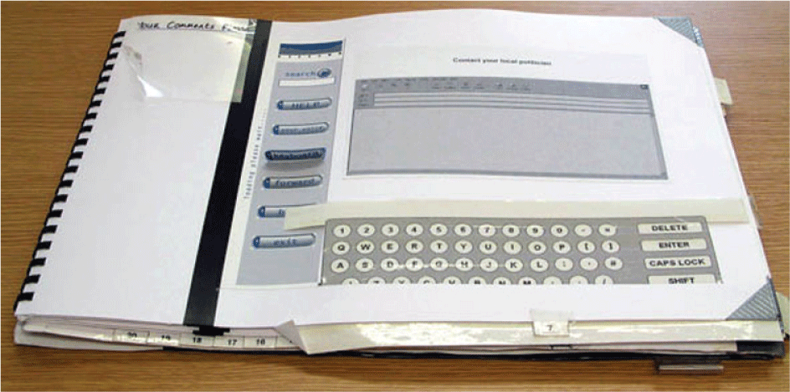
Lo-fi prototypes
Source: David Benyon
Notes:
Figure 8.15 Paper prototype of a messaging screen for a home communications centre

Slide 52
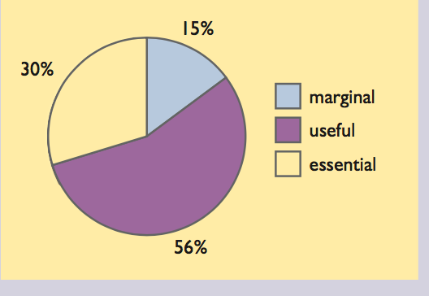
Paper prototypes
Paper prototypes are widely used in practice.
A survey of 172 usability professionals conducted in 2002 asked how important they considered the technique to be in their work (Snyder, 2003).
The responses are shown in the chart below – a ‘useless’ option was included but no one chose it. (The percentages do not sum to 100 per cent because of rounding.)

Slide 53
Practical issues
The main practical issues with designing paper prototypes are as follows:
Robustness. If a paper prototype is to be handled by lots of people, it needs to be tough enough to survive.
Scope. Focus on broad issues and key elements; if you are trying to tell too detailed a story, it can be hard for users to understand.
Instructions. There is a trade-off between adding enough detail for someone to be able to use the prototype without the designer helping and obscuring the design with too much detail.
Flexibility. Have parts of the paper prototype adjustable so that people viewing it can ‘redesign it’ on the fly, for example by using sticky notes to represent parts of the screen where the user can move elements around or add new items.

Slide 54
Video prototypes (1 of 2)
For over 20 years, researchers have highlighted the potential of video as a tool within the participatory design process, from initial observation, through ideas generation and design exploration, what Mackay et al. called ‘video brainstorming’ and ‘video prototyping’ (2000).
Vertelney’s method (1989) involves the creation of a physical mock-up model of the product; a video is then shot with an actor interacting (or ‘acting’) with the model as though it were fully functional.
The product’s display dynamics are simulated in an animation program and are superimposed (or composited) on the video, ensuring synchronization to give the appearance that the product is actually responding to the person’s actions.
The second method suggested by Vertelney is what is sometimes referred to as the ‘weatherman’ technique, where a video image is superimposed onto computer graphics.
Actions are captured against a green screen, allowing removal of the background (via chromakey colour removal) and the superimposition of the video image onto a pre-modelled 3D environment.

Slide 55
Video prototypes (2 of 2)
With appropriate real-world camera movement synchronized with parallel movement within the virtual environment, the resulting composite can have a powerful effect.
What has changed in video prototyping are the tools used to create the video material.
The software tools used in professional film and television production, such as Final Cut Pro (editing and post-production) and Shake (compositing) as well as Adobe’s After Effects (3D animation and rendering) are all well within many people’s budgets.
Furthermore, the advent of technologies such as high definition video has brought high-definition capability at consumer price.
The bottleneck is not with the video production hardware or software now but rather with the skill of the production team and, of course, the ability to put films into the public arena on sites such as YouTube can elicit wide-ranging reactions to design ideas.

Slide 56
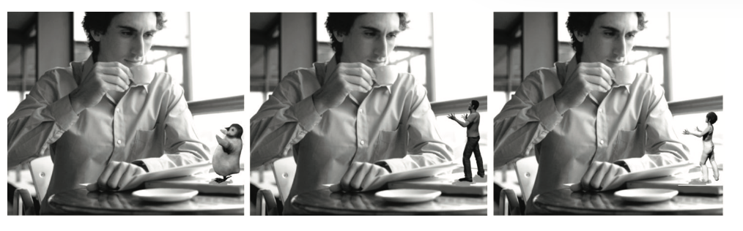
Example
An example of video prototyping comes from a project investigating embodiment issues of the concept of a companion based on the following conceptual scenario:
Lexi is a 3D projected figure that helps its guardian, Tom, by scheduling his personal and work life, keeping him up to date with relevant news articles and being first point of contact for emails, phone calls, text messages and the like. Lexi is a mobile companion who can ‘leap’ from technology to technology as necessary but is most fully realized when projected as a 3D figure on Tom’s tablet.
Using a modelling application such as e-Frontier’s Poser , it is possible to composit different characters onto the baseline video of the companion’s owner (actor) Tom, all of which behave identically but look completely different – in this example, a penguin, a man and a woman. In parallel to this is the ability to alter the vocal characteristics of Lexi, for example pitch, tone, naturalness and so on.
By applying this multi-layered approach, it is possible to produce extremely quickly multiple videos which have only one variable changing from the base line.
Notes:
Figure 8.16 Different embodiments of a companion

Slide 57
Wizard of Oz prototypes
The Wizard of Oz method is a powerful way to prototype as yet underdeveloped technologies. The method is so-called because in the 1953 film The Wizard of Oz, the seemingly powerful wizard with his booming voice is revealed to be a less terrifying character when Dorothy’s dog pulls back a curtain.
In UX design, the Wizard of Oz technique replaces some part of the technology with human intervention, so when a user interacts with the system, a person plays the role that the technology would do in the final operational system.
For example, in one project, were investigating a speech-based user interface to interact with a TV.
Users would say things such as ‘volume up’, ‘channel 3’ and so on and a research hidden from sight would use a remote control to carry out the instructions.
To the user it appeared as if they were controlling the interaction when in reality it was a ‘wizard’.
The ethical issues about using the Wizard of Oz technique remain a bit fuzzy as essentially researchers in this position are fooling the participants in the trial.
In the case above, we did indeed roll back the curtain and reveal the wizard to the users so that they did not think they really had a speech controlled TV.
Nowadays, of course, the TV could be controlled using some software such as Apple’s Siri or Google Talk.

Slide 58
Different approaches to functionality in prototypes
There are several other types of prototype that it is useful to distinguish.
A full prototype provides full functionality but at a lower performance than the target system.
A horizontal prototype aims to go across the whole system but deals only with top-level functions and so much of the detail is omitted.
In contrast, a vertical prototype implements the full range of features, from top to bottom, but is applied to only a small number of functions of the overall system.
Combinations of these are common.
Evolutionary and incremental (a more step-wise version of evolutionary) prototypes eventually develop into the full system.

Slide 59
Envisionment in practice (1 of 2)
In using prototypes, designers may sit alongside the people who will use the final system to make the prototype ‘work’ if it is a lo-fi version.
It helps having two designers, one to ‘play computer’ and one to make notes.
Whatever the type of prototype, record comments and design issues as they arise.
Video can sometimes be useful if there is likely to be a substantial quantity of detailed feedback for other members of the team.

Slide 60
Envisionment in practice (2 of 2)
People find it difficult to react to a prototype if it is just placed in front of them devoid of any context.
Some sort of structuring narrative is required.
The most common strategy is to have people step through a scenario using the new application or to try carrying out one of their current tasks if the application is to replace an earlier system.
For interface design details, set the scene by suggesting what someone would be trying to do with the software at that particular point, for example ‘You are interested in buying the shirt shown on this screen but want to know more about the material – show me what you would do now’.
It is always best if people interact with the prototype themselves, even if only by pointing to a paper button.
This promotes engagement with the questions to be explored and avoids any danger of the person running the prototyping session misinterpreting responses. But there will be cases where this is not feasible.
Perhaps the prototype software is fragile, or the prototype is at a very early stage with very little genuine interactivity.
Here designers can run a video prototype produced in software such as Keynote or PowerPoint. The movie can be paused for discussion as appropriate.

Slide 61
Prototypes and participatory design
Lo-fi prototypes are an essential part of participatory design because people cannot always understand formal models or abstract representations but they can explore and evaluate ideas through engaging with prototyped systems.
People can also be directly involved in prototype design.
During the development of a prototype travel app, we ran a workshop with schoolchildren from a school in rural Scotland.
Using a ‘what will we do tonight’ scenario as a basis, we spent a morning working with the students.
The students were asked to imagine that they and a group of friends had won a trip to the city for the day and had to plan their activities.
We asked participants to use a range of supplied craft materials and information examples to create a mock-up of how they thought the app would look and operate. A number of lo-fi prototypes were quickly produced.

Slide 62
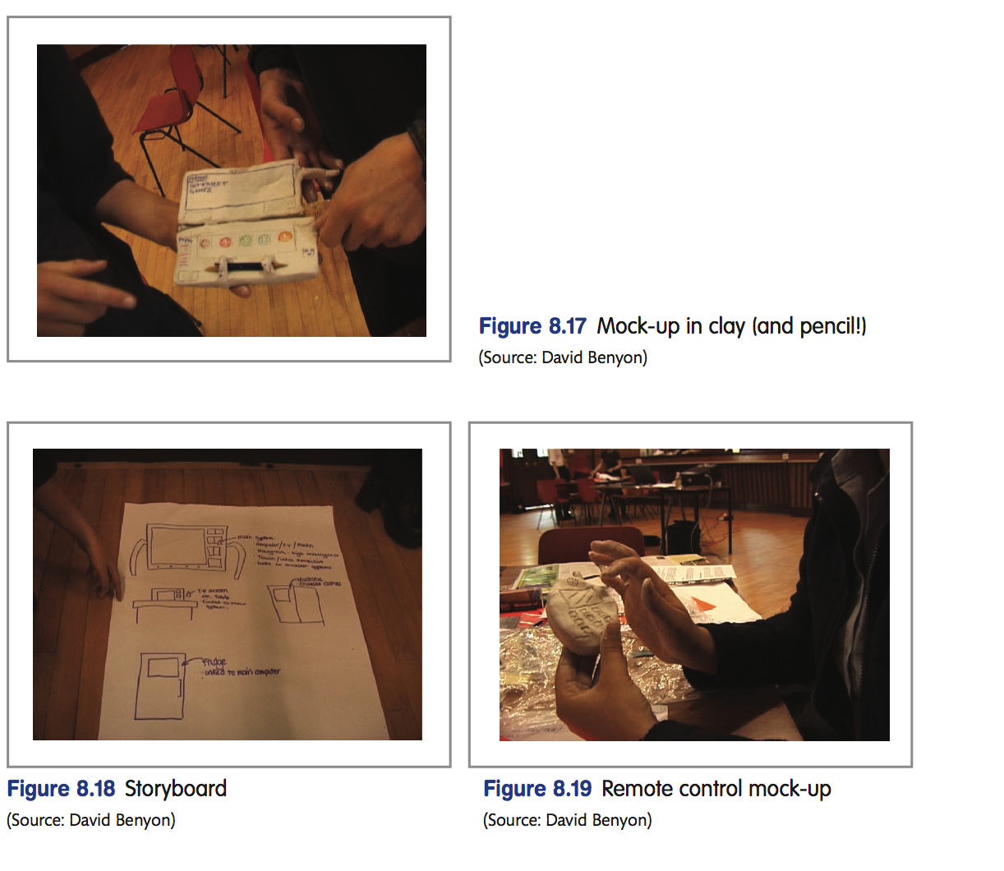
Prototypes

Slide 63
Trade-offs in prototyping (1 of 2)
As with so many aspects of design, the designer has to consider the trade-offs in terms of time, resources, the aim of the evaluation, the stage of the project and so on.
Indeed, when reflecting on how and what to prototype, the designer should think in terms of the PACT elements – people, activities, contexts and technologies.
Who is the prototype aimed at? What is the designer trying to achieve with the prototype?
What stage of the project are things at and what is the context for the use of the prototype?
What technologies (hi-fi or lo-fi) are appropriate?

Slide 64
Trade-offs in prototyping (2 of 2)
Rosson and Carroll (2002) highlight some of these trade-offs:
High-quality graphics and animation can be used to create convincing and exciting prototypes but may also lead to premature commitment to some design decision.
Detailed special-purpose prototypes help answer specific questions about a design but building a meaningful prototype for each issue is expensive.
Realistic prototypes increase the validity of user test data but may postpone testing or require construction of throwaway prototypes.
Iterative refinement of an implementation enables continual testing and feedback but may discourage consideration of radical transformations.

Slide 65
Prototyping throughout the design process
‘Requirements animation’ is a term used to describe the use of prototyping to illustrate requirements. Used at an early stage, a quick prototype can be developed and shown to the client/users for comment on the general design.
Rapid prototyping (also known as ‘throw-it-away’ prototyping) is common in user interface design where software such as PowerPoint or Keynote is used to illustrate concepts. The prototype will be ‘thrown away’ because implementation will be in a different development language.
However, as one famous quotation in software development has it, ‘You will throw away your first few designs, so you might as well plan to throw them away in the first place’.
Use case prototyping is when a ‘polished’ video is produced to disseminate to a wider audience and also to the software and hardware development teams whose job is to bring the product into existence.
The power of this type of video to communicate design requirements in product design as well as service design is extremely strong (Mival, 2004).
In certain designs, this use case will employ a technology beyond what is possible (in the Lexi example, a 3D projection smart pad); we have coined these ‘Future Now’ movies.

Slide 66
Challenge 8.5
Imagine you are presenting your ideas for a diary tool on a smartphone to a small team of developers from the smartphone manufacturer. What type of prototype would you use?

Slide 67
Prototyping tools
Given the wide range of uses for prototyping and the large number of occasions when it is used, it is not surprising that there are a wealth of software ‘tools’ that can be used. A good prototyping tool should:
Allow easy, rapid modification of interface details or functionality.
For designers who are not programmers, allow direct manipulation of prototype components.
For incremental and evolutionary prototypes, facilitate reuse of code.
Not constrain the designer to default styles for interface objects.
Useful tools for requirements animation include paper, PowerPoint (e.g. for illustrating main screens) and drawing packages.
Data manipulation languages such as SQL can be effective in animating the functionality of a system, and vertical or horizontal prototypes can be built using simple application builders that are widely available.
User Interface Kits are collections of tools that help designers rapidly prototype aspects of the interface.

Slide 68
Challenge 8.6
What are the advantages and disadvantages of prototyping software at the very early stages of development?

Slide 69
Presenting designs (1 of 4)
Presenting design ideas clearly and appropriately is a key skill of the designer.
The design process is a long one; with many different stages, there are many different people involved and there are many different reasons for giving a presentation.
The combination of these will affect what sort of presentation and what sort of representation are suitable.
If the ideas are aimed at senior management, for example, then it is likely that the focus is on vision, concepts and key features of design.
People in this position are generally concerned with strategic issues rather than detail, so a presentation to management should focus on impact, image and concept.

Slide 70
Presenting designs (2 of 4)
If the presentation is aimed at the client, then one would expect a bit more detail and some idea of how it works.
If the presentation is aimed at end users, then it is most likely to concentrate on the detail of the design and the workings of the system.
If presenting to the people who will be using the system, it is important to beware of misconceptions about current activities.
It is very easy for people to lose credibility with such an audience if an unrealistic scenario or example is used.

Slide 71
Presenting designs (3 of 4)
The purpose of the presentation is equally important.
If the aim is getting the contract, then the presentation should focus on the big selling point and what it is that distinguishes your design from the others.
If the contract is organized and the aim is agreeing the concept, then the focus will be on restating the client’s brief, clarifying requirements and scoping the area.
Where the presentation is concerned with evaluating a general design idea, or with testing major design features with users, then it must be focused on eliciting an appropriate response.
If the prototype or design is still at the concept stage, broad images of the system are appropriate, with little functionality except in key areas.
An early design will emphasize the design principles and the basis of the design language. It will show how the parts fit together, basic navigational features and so on.
If it is a detailed design, then the correct size is important, along with the proposed shapes, colours and text.

Slide 72
Presenting designs (4 of 4)
Finally, it is important to be clear about what is being highlighted by the presentation.
Is it the functionality and events, or is it the interactions and usability with the focus on look and feel, or ease of use?
If the focus is on content and structure, then attend to what information is there and how it is organized, whereas if it is style and aesthetics, then the focus is on features such as enjoyment, visual and tangible design and use of media.

Slide 73
Summary
In this chapter, we have looked at the main types of envisionment techniques.
These techniques are filtering mechanisms for the designer, effectively screening out parts of the design space that the designer does not want to explore in order to focus on the parts that are of interest.
There are books full of interesting and novel ways of representing aspects of design.
A key feature of design and of the techniques described here is not to sit staring at a blank piece of paper.
Getting inspiration from magazines, websites, software systems, other people, similar systems or products and so on (the importance of examples in design (Herring et al., 2009) and externalizing ideas through envisionment techniques are the first steps in design.

Slide 74
Key points
Envisionment and prototyping bring designs to life for both designers and the people who will use the new designs.
Envisionment – the making of concrete design ideas – is a key feature of UX design. All aspects of the system can and should be envisioned: concepts, functions, structure, interactions and people.
Envisionment aids the generation, communication and evaluation of ideas.
People should take an active part in envisionment wherever possible – the process allows essential feedback from customers and clients.
Basic techniques include storyboards, different forms of sketch, mood boards, maps, wireframes, lo-fi and hi-fi prototypes.
Prototyping may focus on a vertical or horizontal slice through the system, or cover the whole system and may evolve into a final product or be thrown away and re-engineered.

